Slide 1







Sales Performance Analysis
S Q L Q u e r y P r o j e c t
Tools:

Slide 2
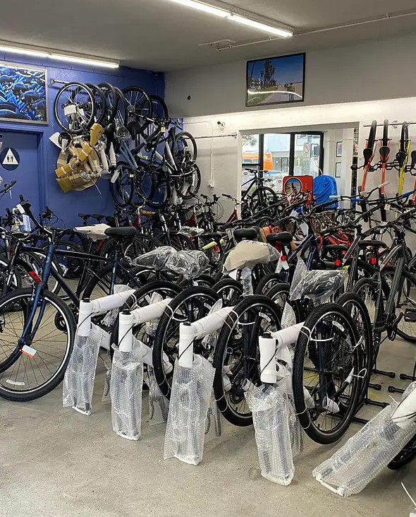
Preliminary
Bee-Cycle is a bicycle manufacturing company. There are 4 product categories:
Bikes (eg Touring, Mountain, etc) Accessories (eg Helm, Lights, etc) Clothing (eg Sock, Jersey, etc) Component (eg wheels, pedal etc)
There are 5 tables used, namely:
dim_product = Product information dim_customer = Customer information dim_territory = Branch store information dim_geography = Geography information fact_sales = Transaction detail
By using SQL and SQLite as RDBMS, we will try to deep dive the data to answer the business questions and retrieve some important actionable insights

Slide 3
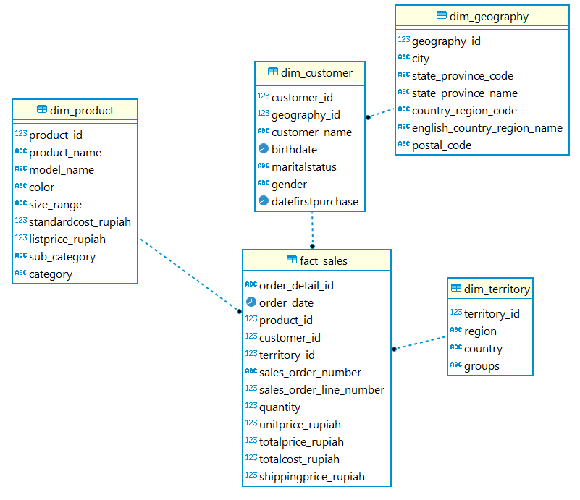
Tables Relation
Business Questions
Top 5 the Most Purchased Product
Top 10 Biggest Profit Product
Top 5 Biggest Customer Purchases
Profit Total Each Store Territory
Highest Product Shipping Cost
New Year Promo
Older Persons Promotion

Slide 4
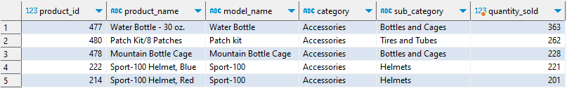
Top 5 the Most Purchased Product
Bicycle accessories (especially bottles and cages) become the product category with the most purchased by customers. We can communicate and give advice to product team to improve or develop new innovation to our accessories product. For marketing team, we can give advice to improve the promotion strategy for the improved product.

Slide 5
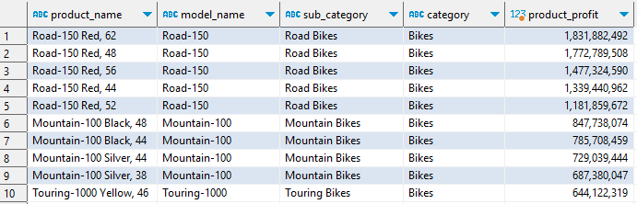
Top 10 Biggest Profit Product
We can see that road bikes produce the biggest profit. We need to monitor this condition while also trying to think of other strategies to improve other products such as mountain bikes, touring bikes, etc.

Slide 6
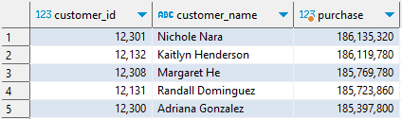
Top 5 Biggest Customer Purchases
We can conclude that these customers are our most loyal customers. It is highly recommended to maintain good relations with these customers, like give them rewards, or discount for certain products.

Slide 7
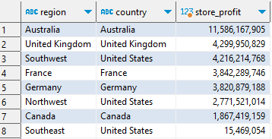
Profit Total Each Store Territory
We can see our branch store in Australia have the biggest profit, meanwhile our branch store in Southeast of United States have the lowest profit. We have to maintain our relationship with our customers in branch store in Australia. For the Southeast of United States branch store, we must do a deep analyze to get the answer why the profit in that area is low, before we do action related this problem.

Slide 8
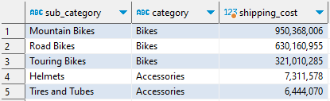
Highest Product Shipping Cost
As expected, bicycle products spend the most on shipping costs compared to other products. We need to compare the shipper agents that we subscribe to with several other shipper agents that are safe and reliable, but have lower costs

Slide 9
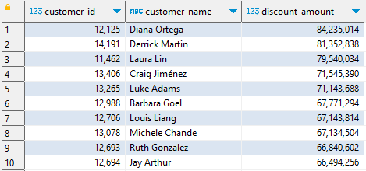
New Year Promo (10 Lucky Customer)
To improve good relations with customers, we need to occasionally hold promotions, one of which is a New Year's promo where the lucky customers born in January get an appropriate discount amount (in this case, customers get 7% discount from their total purchases).

Slide 10
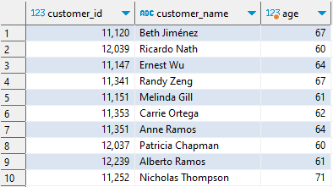
Older Persons Promotion
In commemoration of the International Day of Older Persons, we are holding a promo related to that day, where our loyal customers who are 60 years and over will get a gift in the form of one free bicycle accessory

Slide 11
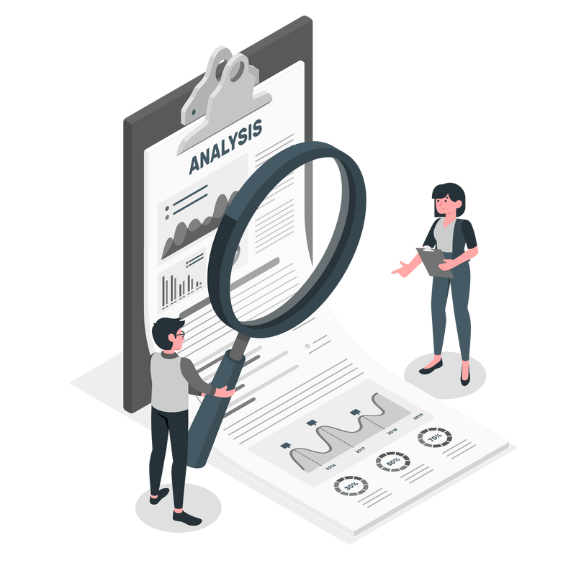
Conclusion
From the results of the analysis we get:
The most purchased products are bicycle accessories (especially bottles and cages)
Road bikes become the main product of the bee-cycle (Generate the biggest profit)
We have several loyal customers that we must maintain so as not to lose customers trust in us
Store branch in Australia generate the biggest profit, meanwhile store branch in Southeast of United States generate the lowest profit
Shipping cost for bicycle product is the highest. We can find alternative good quality shipper agent with the lower cost
New Year promotion for customers who born in January get 7% discount from their purchase total
In commemoration of the International Day of Older Persons, we are holding a promo related to that day, where our loyal customers who are 60 years and over will get a gift
SQL is used to communicate with a database. It is the standard language for relational database management systems (RDBMS).
SQL is a very powerful tool because it is good for creating and managing large databases, which most tech corporations utilize, and also enables you to perform many functions at high efficiency and speed.
Full Documentation

